Slide 1
Chapter 8
Security Issues and Ethics in Education

Slide 2
Chapter Objectives
Identify security risks that threaten home and school computers
Describe how computer viruses and malicious software programs work and the steps you can take to prevent viruses
Describe different ways schools safeguard computers and networks
Explain why computer backup is important and how it is accomplished
Define what is meant by information privacy and its impact on schools
Identify the components of copyright that impact education
Describe the ethical issues related to Internet usage and steps schools are taking to address them
Identify safe and healthy uses of technology resources

Slide 3
Computer Security: Risks and Safeguards
Computer security risk - Any event or action that has the potential of causing a loss of computer equipment, software, data and information, or processing capability
Any illegal act involving a computer generally is referred to as a computer crime

Slide 4
Malware
Short for malicious software, is software designed to infiltrate a computer system without the owner's informed consent.
Malware is a general term for;
Viruses
Worms
Trojan horses
Sypware
Dishonest addware
Crimeware
Rootkits

Slide 5
Computer Virus
Computer program designed to copy itself into other programs, with the intention of causing mischief or damage
A virus is loaded into a computer's memory and instructs its host program to copy the viral code into any number of other programs and files stored in the computer.
When the program is started or the file is accessed a fatal error occurs usually causing the program to shut down or in rare cases the computer to crash.

Slide 6
Worms
A computer worm is a type of virus that replicates itself, but does not alter any files on your machine.
Worms cause havoc by multiplying so many times that they take up all your computer's available memory or hard disk space.
This can lead to denial of service.

Slide 7
Trojan horses
A Trojan horses is a software programs that masquerade as a regular program, such as games, disk utilities, and even antivirus programs.
A Trojan horse might appear to be a computer game, but once you double-click it, the program starts writing over certain parts of your hard drive, corrupting your data.

Slide 8
Spyware
As the name implies, this is software that "spies" on your computer
Spyware can capture information like Web browsing habits, e-mail messages, usernames and passwords, and credit card information.
If left unchecked, the software can transmit this data to another person's computer over the Internet.

Slide 9
Signs of Malware Infection
An unusual message or graphical image appears on the computer screen.
An unusual sound or music plays randomly.
The available memory is less than what should be available.
A program or file suddenly is missing.
An unknown program or file mysteriously appears.
The size of a file changes without explanation.
A file becomes corrupted.
A program or file does not work properly

Slide 10
Preventing Malware from Infecting Your Computer
Install an antivirus program on all of your computers
Never open an e-mail attachment unless you are expecting it and it is from a trusted source
If the antivirus program flags an e-mail attachment as infected, delete the attachment immediately
Check all downloaded programs for viruses, worms, or Trojan horses

Slide 11
Anti-virus Programs
Identifies and removes computer viruses
Most also protect against worms and Trojan horses
Most anti-virus programs provide more then just virus protection.

Slide 12
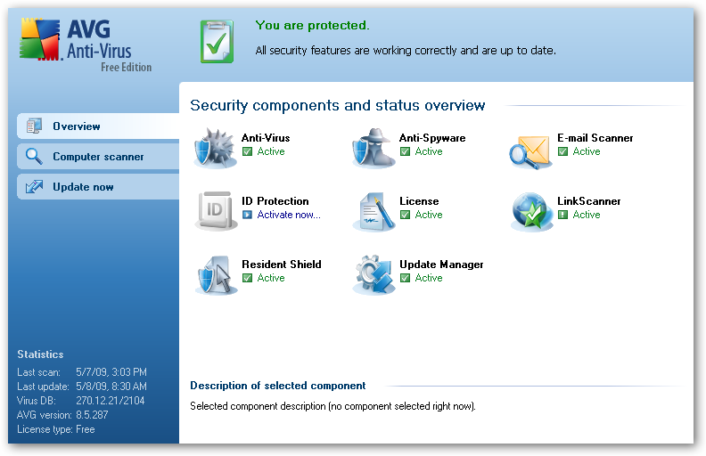
Anti-virus Programs

Slide 13
Internet and Network Attacks
A denial of service attack is an assault which disrupts computer access to an Internet service such as the Web or e-mail
A back door is a program or set of instructions in a program that allow users to bypass security controls when accessing a computer resource
Spoofing is a technique intruders use to make their network or Internet transmission appear legitimate to a victim computer or network

Slide 14
Firewall
A computer firewall limits the data that can pass through it and protects a networked server or client machine from damage by unauthorized users.
Firewalls can be either hardware or software-based.

Slide 15
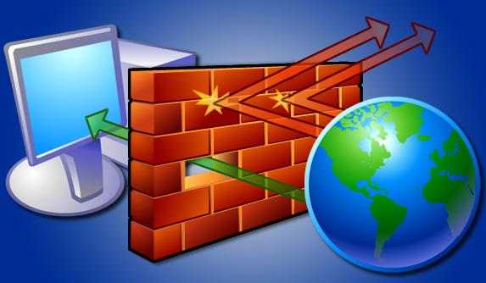
Firewall

Slide 16
User Names and Passwords
Unauthorized Access and Use
Crackers and hackers
Access controls
Identification
Authentication
User name - Unique combination of characters that identifies user
Password is private combination of characters associated with the user name that allows access to computer resources

Slide 17
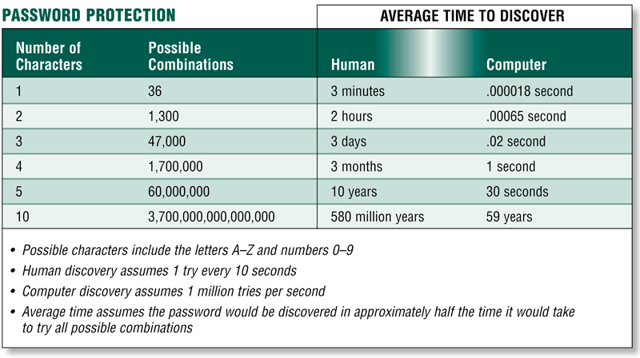
User Names and Passwords

Slide 18
Computer Security: Risks and Safeguards
Possessed Objects and Biometric Devices
A possessed object is any item that you must carry to gain access to a computer or computer facility
Badges, cards, smart cards, and keys
Personal Identification Number (PIN)
Biometric devices authenticate a person’s identity with a personal characteristic

Slide 19
Computer Security: Risks and Safeguards
Hardware Theft and Vandalism
Cable lock devices
Portable equipment warrants special considerations
Computer vandalism
Cutting cables
Deleting software
Smashing computer
Software Theft
Software piracy
Software license
Single-user license
Multiple-user
Network license
Community/State license

Slide 20
Safeguards Against Software Theft
Product activation allows user to input product identification number online or by phone and receive unique installation identification number
Business Software Alliance (BSA) promotes better understanding of software piracy problems

Slide 21
Encryption
Encryption is the coding or scrambling of information so that it can only be decoded and read by someone who has the correct decoding key. Encryption key (formula) often uses more than one method
Encryption is used in secure Web sites as well as other mediums of data transfer.

Slide 22
Buying Online
Make sure that when you enter the shopping cart are the address changes to https://- secure socket layer
Look for the following logos at the bottom of the home page of the merchants Web site.

Slide 23
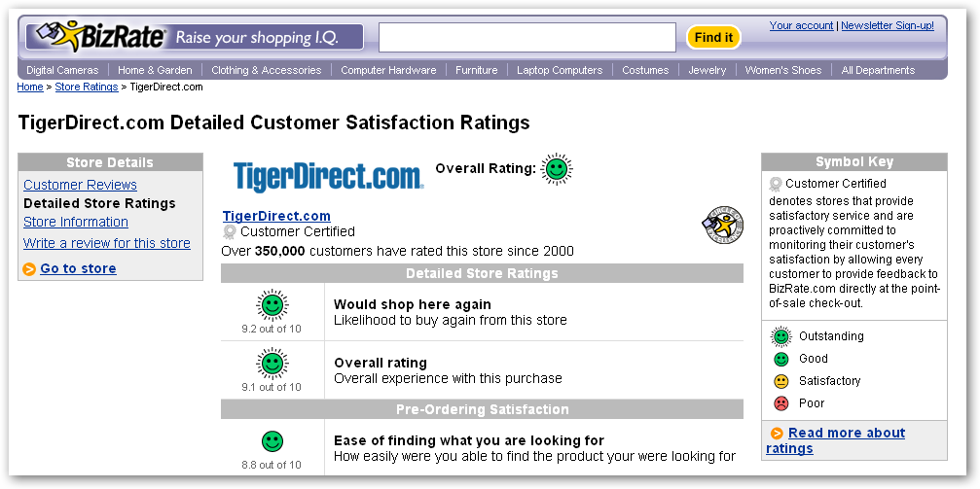
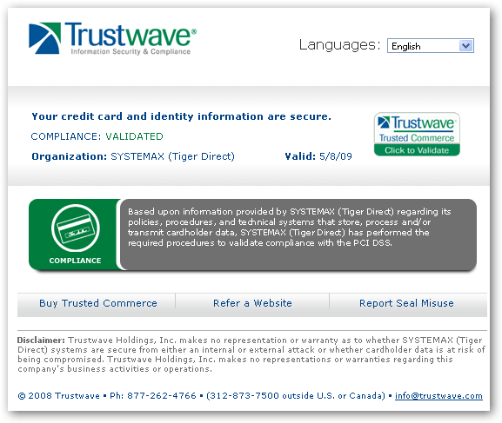
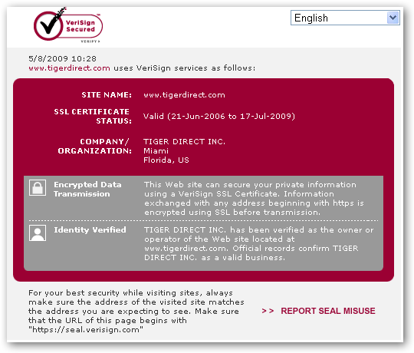
Buying Online -Certification

Slide 24
Systems Failure
Prolonged malfunction of computer
Can cause loss of hardware, software, or data
Caused by aging hardware, natural disasters, or electrical power disturbances
Electric power disturbances
Noise—unwanted electrical signal
Under-voltage—drop in electrical supply
Overvoltage or power surge—significant increase in electrical power

Slide 25
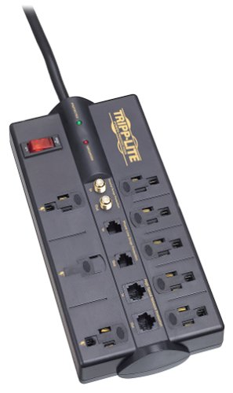
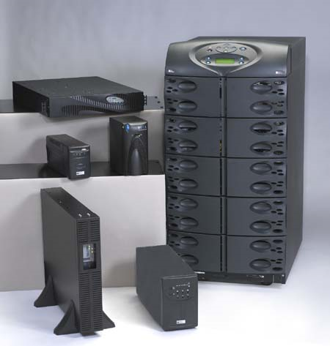
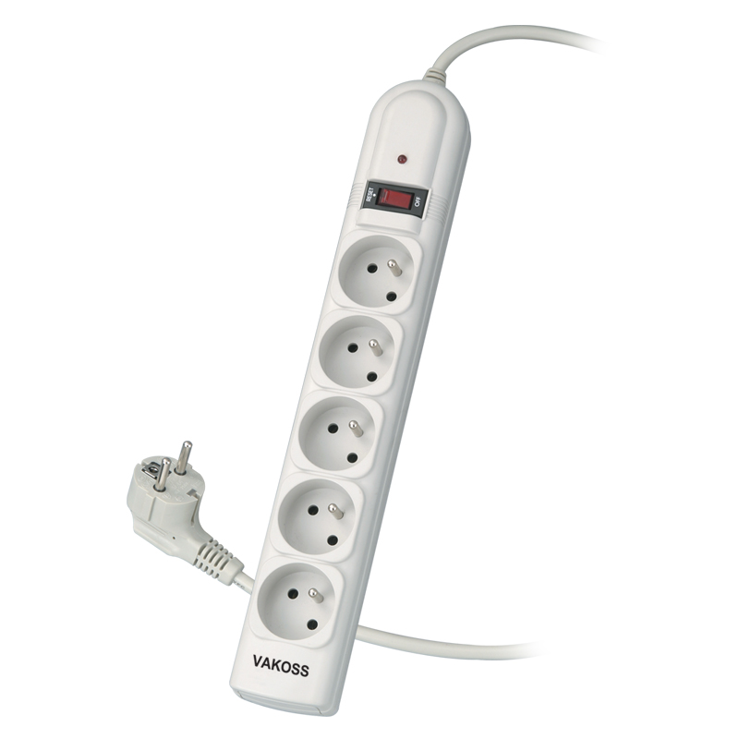
Power Protection
Surge protector – protects equipment from noise and over voltage
Uninterruptible power supply (UPS) - protects equipment from noise and over voltage and under voltage.

Slide 26
Backing up Your Data
How important is your data?
You can back up on a random basis on to CD/DVD/Blue Ray disks or attached hard drives.
You can automate back up onto internal or external hard drives.
You can set up a RIAD 1 system which is mirroring of drives.

Slide 27
Ethics and the Information Age
Computer ethics
Moral guidelines that govern the use of computers, networks, and information systems
Unauthorized use of computers
Hardware, software, and information theft
Information Privacy
Copyright
Existence of objectionable materials on the Internet

Slide 28
Ethics and the Information Age
Information Privacy
The right of individuals and organizations to deny or restrict the collection and use of information about them
Unauthorized collection and use of information
Electronic profiles
Federal and state laws

Slide 29
Ethics and the Information Age
Computer Ethics for Educators
An educator will not use a computer to harm other people.
An educator will not interfere with others’ computer work.
An educator will not look at others’ computer files.
An educator will not use a computer to steal.
An educator will not use a computer to lie.
An educator will not copy or use software without paying for it.
An educator will not use others’ computer resources without permission.
An educator will not use others’ work.
An educator will think about the social impact of the programs he or she creates.
An educator always will use a computer in a way that shows respect and consideration for other people.
Modified from the Ten Commandments for Computer Ethics by the Computer Ethics Institute.

Slide 30
Ethics and the Information Age
Phishing
Email attempting to obtain personal and financial information
Spam
An unsolicited e-mail mess or newsgroup posting sent to many recipients or newsgroups at once
Average user receives more than 1,000 spam e-mail messages each year
Spam sent through instant messaging is called spim
Spam sent via Internet Telephony is called split

Slide 31
Ethics and the Information Age
Privacy Laws
Business or government agencies should only collect information necessary to carry out their functions
Restrict data access to those who must use it to perform job duties
Release personal information only after agreement to disclosure by individual
Must inform the individual when collecting information

Slide 32
Information Privacy
Right of individuals and companies to deny or restrict collection and use of information about them
Difficult to maintain today because data is stored online
Employee monitoring is using computers to observe employee computer use
Legal for employers to use monitoring software programs

Slide 33
Ways to Safe Guard Personal Information
Fill in only necessary information on rebate, warranty, and registration forms
Avoid shopping club and buyers cards
Inform merchants that you do not want them to distribute your personal information
Limit the amount of information you provide to Web sites, fill in only required information
Install a cookie manager to filter cookies
Clear your history file when you are finished browsing

Slide 34
Ways to Safe Guard Personal Information
Set up a free e-mail account; use this e-mail address for merchant forms
Turn off file and print sharing on your Internet connection
Sign up for e-mail filtering through your Internet service provider or use an antispam program, Do not reply to spam for any reason
Surf the Web anonymously with a program such as Freedom Web Secure or through an anonymous Web site such as Anonymizer.com

Slide 35
Ethics and the Information Age
Employee and Student Monitoring
Use of computers to observe, record, view, and review an individual’s use of a computer
Policies of computer use
Acceptable Use Policy (AUP)

Slide 36
Ethics and the Information Age
Copyright Laws
Copyright Act of 1976
Illegal copying
Fair use
The purpose and character of the use, including whether such use is of commercial nature or is for nonprofit educational purposes
The nature of the copyrighted work
The amount and substantiality of the portion used in relation to the copyrighted work as a whole
The effect of the use upon the potential market for, or value of, the copyrighted work
Teacher and student Web pages
Copyright laws do protect these pages
Public domain Web sites
CDs and DVDs with images, graphics, audio, and video clips
Guidelines for creating Web pages

Slide 37
Web Page Guidelines
Always protect the identity of your students.
Never list students’ last names, telephone numbers, home addresses, or e-mail addresses.
Use only first names of students on a Web site, but never in conjunction with other identifying information, such as a photograph.
Use caution when including digital pictures of classrooms; avoid pictures that show close-ups of students.
Never provide links to sites that are not appropriate for K-12 students or educational settings.
List the function of all linked Web pages. Link only to pages that inform, explain, or teach a concept or curriculum area to students. Beware of linking to Web sites that persuade students.

Slide 38
Web Page Guidelines
Avoid providing links to sites whose primary purpose is selling noneducational products and services, unless relevant to the subject under discussion.
Avoid linking to Web pages that are not updated on a regular basis.
Provide links to sites that help you achieve instructional and curriculum goals.
Avoid discussing controversial issues on your Web site or linking to Web sites that discuss controversial issues, unless these issues are part of your curriculum.
Carefully read and follow all guidelines and policies that your school district provides.

Slide 39
Internet Ethics and Objectionable Materials
Three categories of objectionable material
Pornographic material
Racist literature, gambling
Incorrect or inappropriate material
Inaccurate information

Slide 40
Internet Ethics and Objectionable Materials
Government Actions
Children’s Internet Protection Act
Protects children from obscene, pornographic, and other information considered to be harmful to minors
See page 429 in book for a list of laws that effect what controls teachers actions.
Parental Controls
Filtering software programs
Available in Windows and Mac operating systems
Determine proper controls for children in different age groups
Monitor child’s use of computer

Slide 41
Internet Ethics and Objectionable Materials
Educational Controls
Acceptable Use Policies (AUP)
Use of network is a privilege, not a right
Behave as if you are a guest on the Internet
Rules concerning objectionable sites
Rules concerning copyright issues
Outline proper use of equipment
Online safety and personal information
Consequences of violating rules
Curriculum resource pages
Acts as guides for students
Sites are pre-evaluated by teachers
Eliminates typing mistakes when typing URLs

Slide 42
Internet Ethics and Objectionable Materials
Educational Controls
Teacher observation
Final measure to prevent students from accessing objectionable and inappropriate materials
Instruct students on use of Back button on the browser
Understanding of ethical concepts

Slide 43
Green Computing
Involves reducing the use of electricity and the production of environmental waste while using a computer
Society and schools are taking measures to combat it

Slide 44
Health Issues
Computers and Health Issues
Musculoskeletal Disorder (MSD)
Repetitive Strain Injury (RSI)
Carpal Tunnel Syndrome (CTS)
Hand Exercises
Computer Vision Syndrome (CVS)
Techniques to ease eyestrain

Slide 45
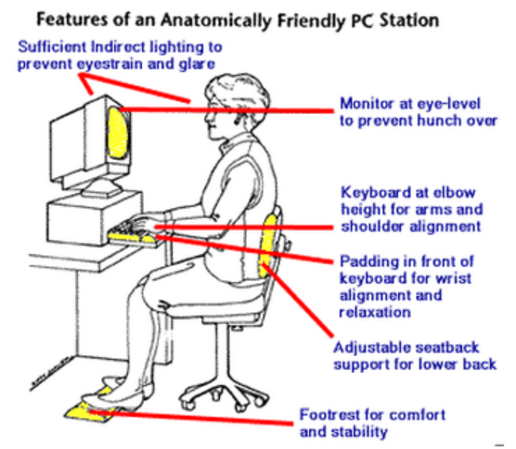
Health Issues
Ergonomics
An applied science devoted to incorporating comfort, efficiency, and safety into the design of items in the workplace

